Slide 1
Data Analysis using Pandas

Slide 2
The pandas library is useful for dealing with structured data. What is structured data?
Data that is stored in tables, such as CSV files, Excel spreadsheets, or database tables, is all structured. Unstructured data consists of free form text, images, sound, or video. If you find yourself dealing with structured data, pandas will be of great utility for us.
Pandas Data Structure
Series
DataFrame
Panel
1D data structure:
Column-vector of DataTable
2D data structure:
Table
3D data structure

Slide 3
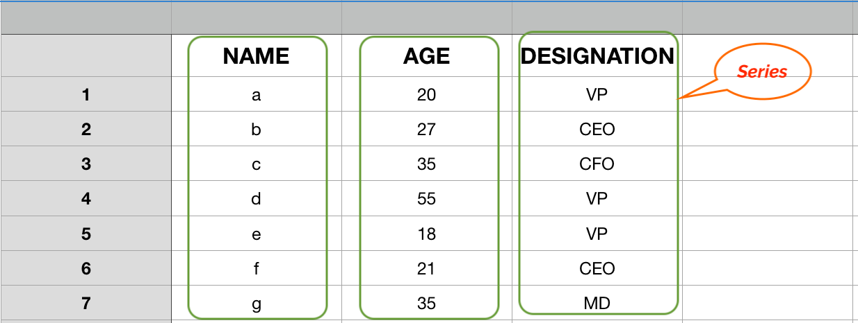
How do we construct pandas series
Series is a one-dimensional array like structure with homogeneous data. Technically, Pandas Series is a one-dimensional labelled array capable of holding any data type
The general way to create a Series is to call:
pd.Series(data, index=index)
Here, data can be an NumPy’s ndarray, Python’s list, or a scalar value (like 5). The passed index is a list of axis labels.

Slide 4
Series Methods
Let us use “movies.csv” for understanding series methods and attributes.
series.method() | Description
.head() | lists the first five entries of a Series
.value_counts() | calculates the frequencies
.value_counts(normalize=True) | relative frequencies
.size() ,.shape(),len() | Count the number of elements
.unique() | unique values
.count | number of non-missing values

Slide 5
Series Methods
Data Analysis
.min() | Minimum
.max() | Maximum
.mean() | Mean
.median() | Median
.std() | standard deviation
.describe() | summary statistics
Data Analysis methods for series
Missing Values
.isna() | Missing values. Returns T/F
.fillna(0) | Fill missing values with zero
.dropna() | Drop the missing value records
Missing value identifications and treatment
methods for series

Slide 6
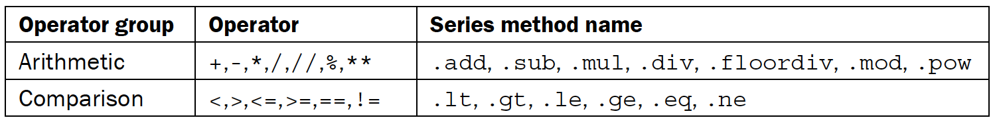
Series operations
There exist a vast number of operators in Python for manipulating objects. For instance, when
the plus operator is placed between two integers

Slide 7
Chaining Series methods
In Python, every variable points to an object, and many attributes and methods return new objects. This allows sequential invocation of methods using attribute access. This is called method chaining or flow programming.
For example, let's take an English sentence and translate the chain of events into a chain of methods
Consider the sentence: ‘A person drives to the store to buy food, then drives home and prepares, cooks, serves, and eats the food before cleaning the dishes’
(
person.drive('store')
.buy('food')
.drive('home')
.prepare('food')
.cook('food')
.serve('food')
.eat('food')
.cleanup('dishes')
)
The person is the object (or instance of a class) that calls a method.
Each method returns another instance that allows the chain of calls to happen. The parameter passed to each of the methods specifies how the method operates
How to do that…

Slide 8
Downside of chain rule
One potential downside of chaining is that debugging becomes difficult.
Because none of the intermediate objects created during the method calls is stored in a variable, it can be hard to trace the exact location in the chain where it occurred.
So we can typically build up these chains one method at a time

Slide 9
Pandas DataFrames

Slide 10
A Data frame is a two-dimensional data structure, i.e., data is aligned in a tabular fashion in rows and columns.
Features of DataFrame:
Potentially columns are of different types
Labelled axes (rows and columns)
Can Perform Arithmetic operations on rows and columns
director_name | num_critic_for_reviews | duration
James Cameron | 723 | 178
Gore Verbinski | 302 | 169
Sam Mendes | 602 | 148
Christopher Nolan | 813 | 164
Doug Walker
Andrew Stanton | 462 | 132
Sam Raimi | 392 | 156
Nathan Greno | 324 | 100

Slide 11
There are many ways to create a DataFrame. Usually, we create a DataFrame from an existing file or a database,
but we can also create one from scratch.
DataFrame from dictionary of lists
DataFrame from list of dictionaries
DataFrame from list of lists
Dataframe from dictionary of pandas Series
CSV files
Excel files
Large csv files using dask library

Slide 12
Summarizing a DataFrame
When we call these summarization methods from a DataFrame, they perform that operation for each column at once and reduce the results for each column in the DataFrame.
They return a Series with the column names in the index and the summary for each column as the value.
Read in the dataset, and let us examine the basic descriptive properties.
.shape, .size, and .ndim , .count , .min, .max, .mean, .median, and .std, .describe
How to do that…

Slide 13
Data Frames: Slicing
When selecting one column, it is possible to use single set of brackets, but the resulting object will be a Series (not a DataFrame):
In [ ]:
#Select column salary:
df['salary']
When we need to select more than one column and/or make the output to be a DataFrame, we should use double brackets:
In [ ]:
#Select column salary:
df[['rank','salary']]

Slide 14
Data Frames: Selecting rows
If we need to select a range of rows, we can specify the range using ":"
In [ ]:
#Select rows by their position:
df[10:20]
Notice that the first row has a position 0, and the last value in the range is omitted:
So for 0:10 range the first 10 rows are returned with the positions starting with 0 and ending with 9

Slide 15
Data Frames: method iloc (summary)
df.iloc[0] # First row of a data frame
df.iloc[i] #(i)th row
df.iloc[-1] # Last row
df.iloc[:, 0] # First column
df.iloc[:, -1] # Last column
df.iloc[0:7] #First 7 rows
df.iloc[:, 0:2] #First 2 columns
df.iloc[1:3, 0:2] #First and Second rows and first 2 columns
df.iloc[[0,5], [1,3]] #1st and 5th rows and

Slide 16
Selecting multiple DataFrame columns
We can select a single column by passing the column name to the index operator of a DataFrame.
It is often necessary to focus on a subset of the current working dataset, which is accomplished by selecting multiple columns
Read in the dataset, and pass in a list of the desired columns to the indexing operator
We can also use .loc to pull out a column by name. Because this index operation requires that we pass in a row selector first, we will use a colon (:) to indicate a slice that selects all of the rows.
How to do that…

Slide 17
Selecting columns with methods
Although column selection is usually done with the indexing operator, there are some DataFrame methods that facilitate their selection in an alternative manner.
The .select_dtypes and .filter methods are two useful methods to do this.
.select_dtypes
include
exclude
.filter
items
like
How to do that…

Slide 18
Chaining DataFrame methods
One of the keys to method chaining is to know the exact object being returned during each step of the chain. In pandas, this will nearly always be a DataFrame, Series, or scalar value
isnull().head()
isnull().sum().head() : .sum method that interprets True and False as 1 and 0, respectively. Because this is a reduction method, it aggregates the results into a Series
isnull().sum().sum() : We can go one step further and take the sum of this Series and return the count
of the total number of missing values in the entire DataFrame as a scalar value

Slide 19
Data Analysis

Slide 20
Let us see basic information about the data set and descriptive stats using
.info()
.describe() etc.. Methods
Slice and dice data:
Top 10 values ,
last 10 values
Largest group etc based on criteria

